Slide 1
MER311: Advanced Strength of Materials
LECTURE OUTLINE
Strain Transformatins
Mohr’s Circle for Strain

Slide 2
Strain Tensor

Slide 3
Strain Transformations

Slide 4
Two Dimensional/Plane Strain Transformations
General Transformation Equations
Principal Strains

Slide 5

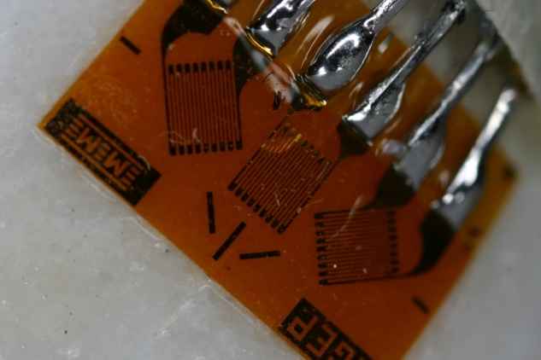
Typical Strain Gage Rosettes
45°
c
45°
b
a

Slide 6
Typical Strain Gage Rosettes
axial
hoop
a
45°
c
b
45°
|ε_{a*}|= ε_{a} = 1237(10⁻⁶) in/in = 1237με (12)
|ε_{b*}|= ε_{b} = 1270(10⁻⁶) in/in = 1270με (13)
|ε_{c*}|= ε_{c} = 402(10⁻⁶) in/in = 402με (14)

Slide 7
Transverse Sensitivity
(1)
(2)
(3)

Slide 8
Mohr’s Circle for Strain
ε_{c2}
ε_{a1}
45°
ε_{b2}
ε_{p2}
ε_{p1}
a
45°
b
ε_{b1}
ε_{c1}
ε_{a2}
ε_{c}
c
|ε_{a}-ε_{c}|
ε_{a}
ε_{b}
|ε_{a*}|= ε_{a} = 1237(10⁻⁶) in/in = 1237με
|ε_{b*}|= ε_{b} = 1270(10⁻⁶) in/in = 1270με
|ε_{c*}|= ε_{c} = 402(10⁻⁶) in/in = 402με

Slide 9
Mohr’s Circle for Strain
2|ε_{ave}-ε_{b}|=|ε_{a}+ε_{c}-2ε_{b}|
ε_{ave}=½(ε_{a}+ε_{c})
|ε_{ave}-ε_{b}|
ε_{c2}
ε_{a1}
45°
ε*
ε_{b2}
2⋅φ
ε_{p2}
ε_{p1}
h₂
h₁
a
45°
b
2⋅φ
ε_{b1}
ε_{c1}
ε_{a2}
ε_{c}
c
|ε_{a}-ε_{c}|
ε_{a}
ε_{b}
|ε_{a*}|= ε_{a} = 1237(10⁻⁶) in/in = 1237με
|ε_{b*}|= ε_{b} = 1270(10⁻⁶) in/in = 1270με
|ε_{c*}|= ε_{c} = 402(10⁻⁶) in/in = 402με

